Slide 1
Nutrition & Statistics Research Project
By Group 14 - Nina, Shirley, Sungho, Sybilla and Yueyi

Slide 2
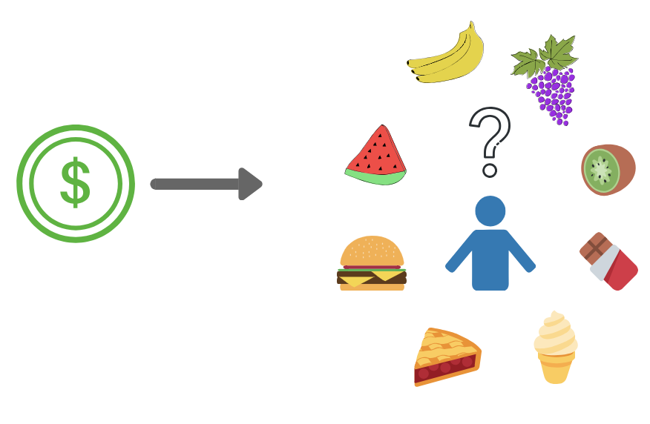
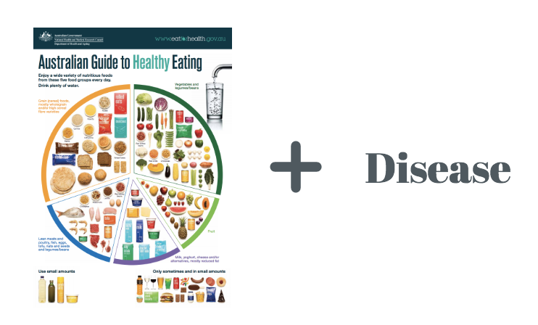
The Australian Health Survey: Our Aims and Motivation...
To determine if the socioeconomic status of an individual impacts their health, and the types of foods they eat?
To analyse the relationship between metabolic disease (hypertension, high blood glucose levels, obesity) and the types/amounts of food people eat?
Australian Guide to Healthy Eating
(The Australian Government)

Slide 3
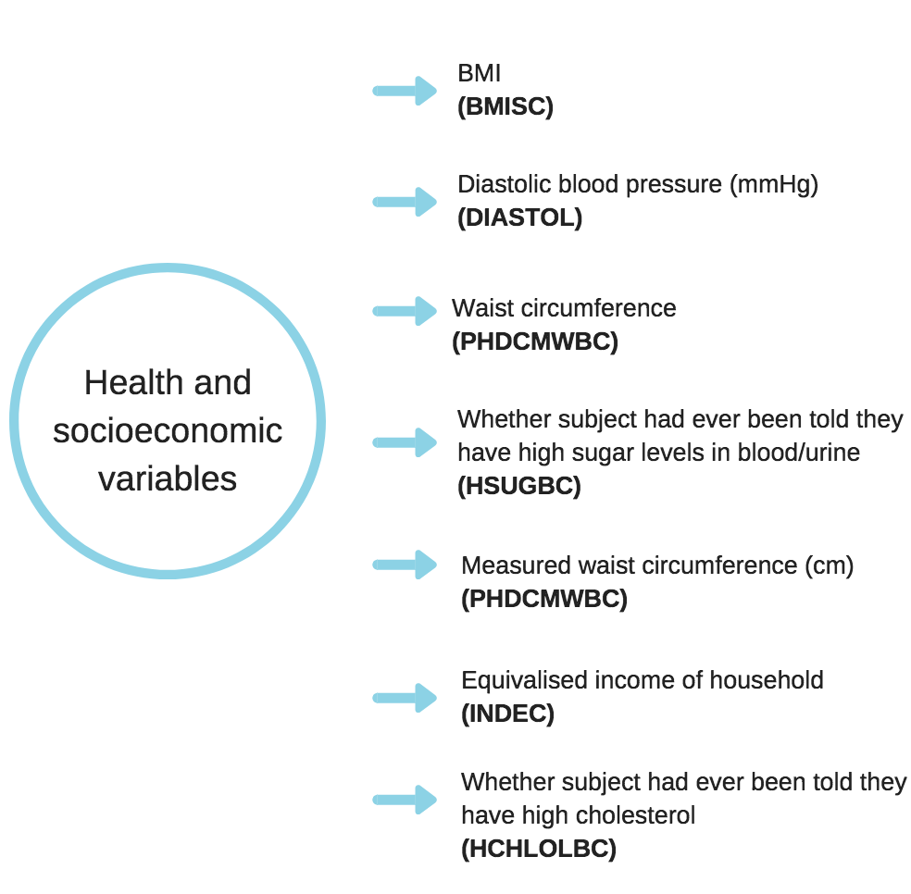
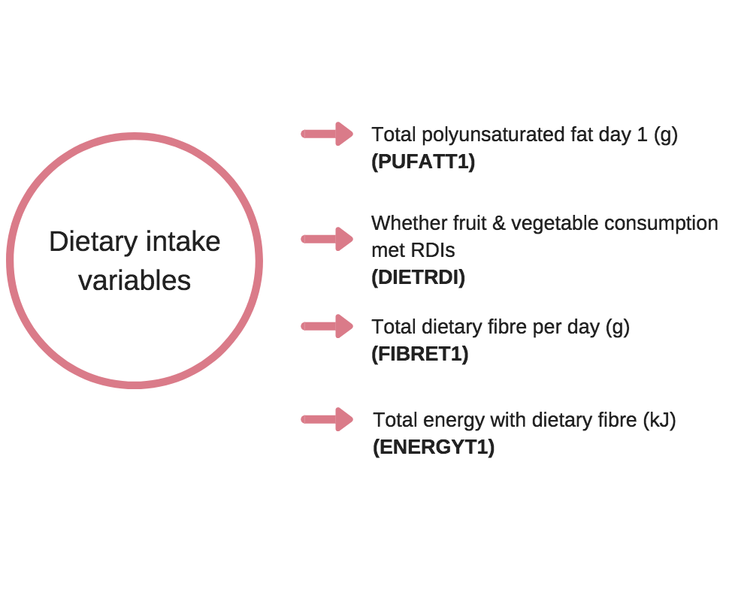
The Background to Our Project...
Data obtained from: Australian Health Survey 2011-12

Slide 4
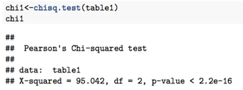
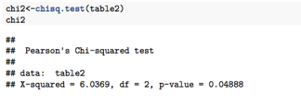
Statistics: Methods and Results...
High blood serum cholesterol levels (HCHOLBC), high blood glucose (HSUGBC) and hypertension (HYPBC) were used to determine whether a correlation is present between an individual’s income status and disease.
Dependency structure between an
individual’s income levels and whether they suffer from high cholesterol levels.
Dependency between socioeconomic status and high sugar levels.

Slide 5
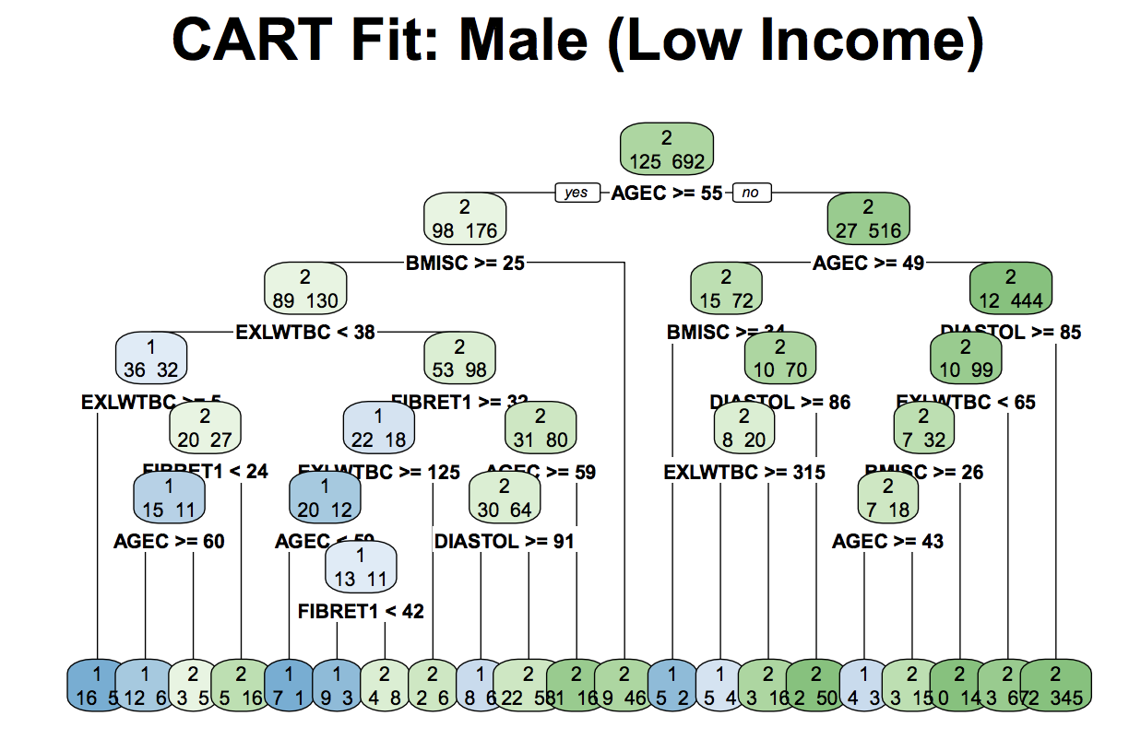
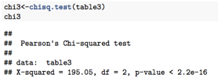
Statistics: Methods and Results (cont…)
Hypertension -
Dependency structure between income and whether the individual suffers from hypertension.

Slide 6
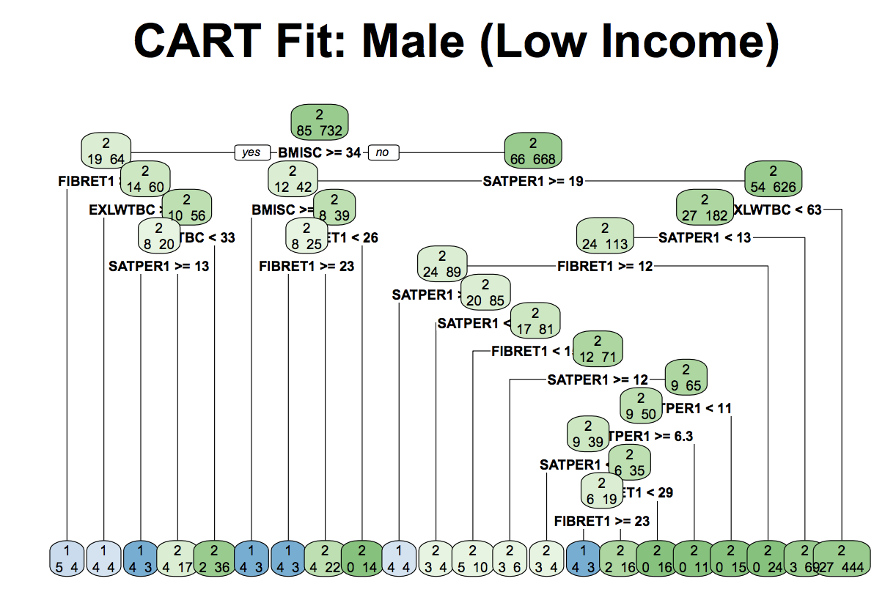
Statistics: Methods and Results (cont…)
High Cholesterol -

Slide 7
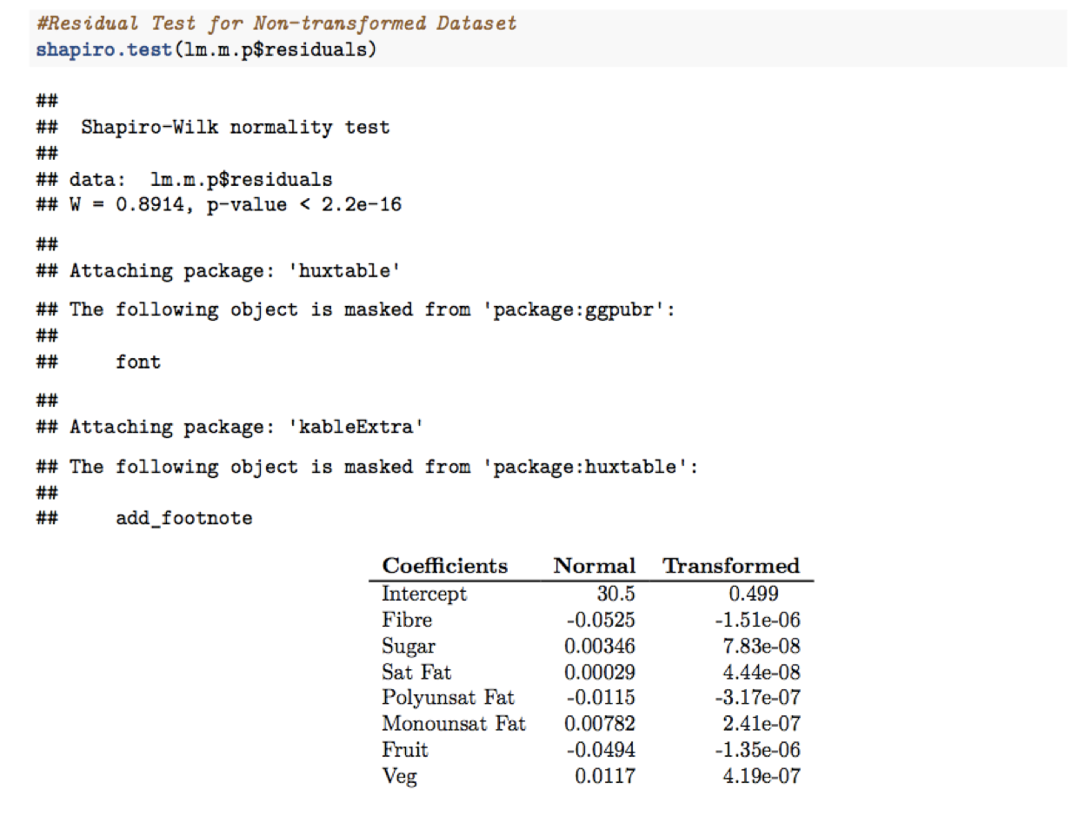
Statistics: Methods and Results (cont…)
Conclusions from Multivariate Linear Regression and Principal Component Analysis in highlighting dietary trends of individuals with low income.

Slide 8
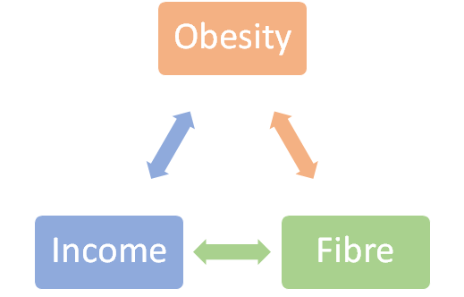

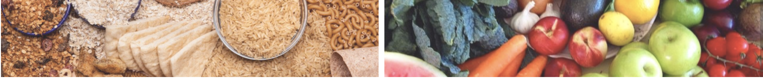
Nutrition: Previous relationships found in the research...
Effects of Income:
Poverty and lack of education lead to higher obesity rate
Energy density of food negatively relative with food cost
Benefits of fibre has been proved:
Lower the risk of diabetes & CVD
Good for bowel health
Increase satiety, thus better food control and energy balance
(Drewnowski & Specter, 2004; Monteiro et al., 2001; Buttriss & Stokes, 2008)

Slide 9
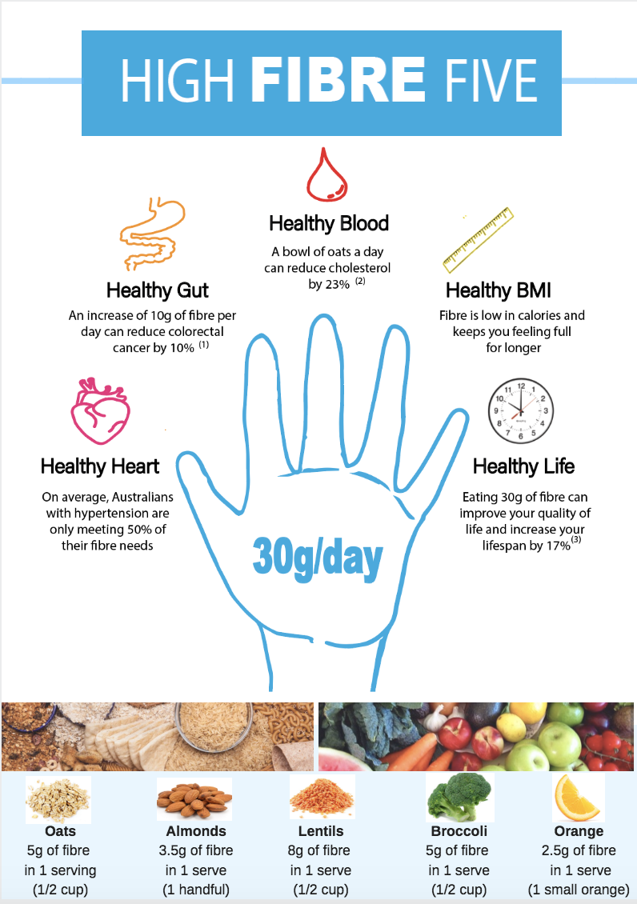
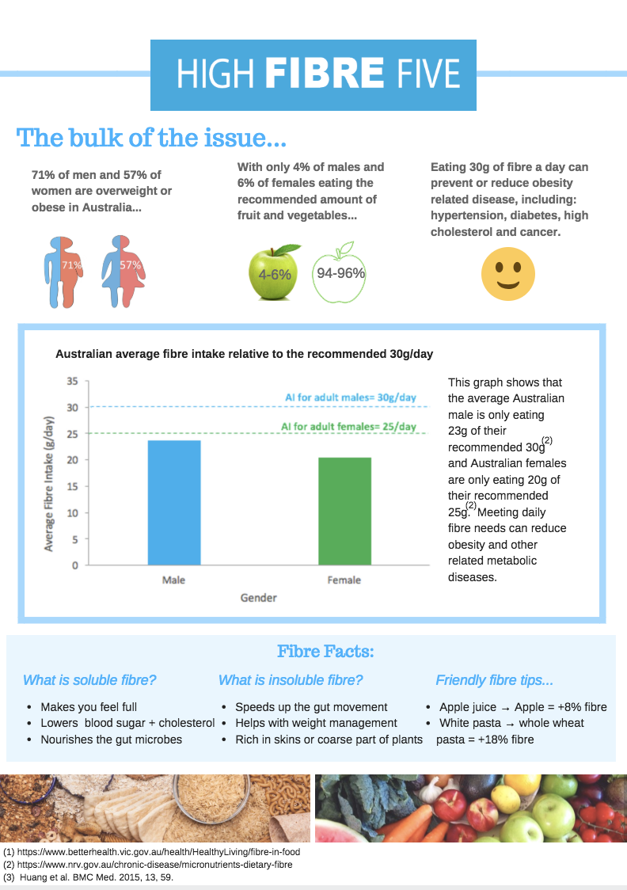
Nutrition: Dietary Fibre and Our Multimedia Approach...
Research shows fibre to be an effective dietary intervention for mediating or even preventing metabolic disease, yet it is so rarely talked about.

Slide 10
Nutrition: Methods and Results...
What we did it:
We have created a double sided poster using data wrangled and cleaned by our statistics friends.
We chose this approach as it is in line with a lot of government initiatives to create awareness.
What we found:
71% of men and 57% of females are overweight or obese.
Adequate intake (AI) of fibre is 30g/day for men and 25g for females. We found the average Australian is missing this by nearly 20%.
Only 4% males and 6% females eat their RDI of fruit and veg/day (2 fruit + 5 veg).
Australians with hypertension are only having on average, 50% of their fibre needs per day.

Slide 11
References...
Buttriss, J. L., & Stokes, C. S. (2008). Dietary fibre and health: an overview. Nutrition Bulletin, 33(3), 186-200.
Drewnowski, A., & Specter, S. E. (2004). Poverty and obesity: the role of energy density and energy costs. The American journal of clinical nutrition, 79(1), 6-16.
Monteiro, C. A., Conde, W. L., & Popkin, B. M. (2001). Independent effects of income and education on the risk of obesity in the Brazilian adult population. The Journal of nutrition, 131(3), 881S-886S.
The Australian Government (2017) Guide to Healthy Eating. Cited: October 2018 https://www.eatforhealth.gov.au/guidelines/australian-guide-healthy-eating

